Slide 1
Chapter 10 Sinusoidal Steady-state Analysis
Introduction
Nodal analysis
Mesh analysis
Superposition theorem

Slide 2
Chapter 10 Sinusoidal Steady-state Analysis
Source transformation
Thevenin and Norton equivalent circuits
Op amp ac circuits

Slide 3
Chapter objectives
Apply previously learned circuit techniques to sinusoidal steady-state analysis
Learn how to apply nodal and mesh analysis in the frequency domain
Learn how to apply superposition, Thevenin’s and Norton’s theorems in the frequency domain
Learn how to analyze AC Op Amp circuits

Slide 4
Key points
Be able to apply previously learned circuit techniques to sinusoidal steady-state analysis
Nodal and mesh analysis
Superposition theorem
Thevenin’s and Norton’s theorems

Slide 5
10.1 Introduction
Steps to analyze ac circuits:
Transform the circuit to the phasor or frequency domain;
Solve the problem using circuit techniques (nodal and mesh analysis, superposition, etc);
Transform the resulting phasor to the time domain if necessary.

Slide 6
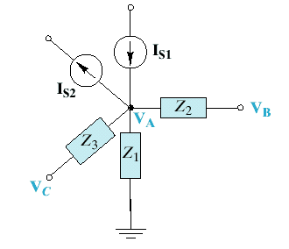
10.2 Nodal analysis
An example node

Slide 7
Example： Find i_{x} in the circuit using nodal analysis.
10Ω
1H
Solution：
i_{x}
We first convert the circuit to the frequency domain:
0.5H
0.1F
2i_{x}
20cos4t V
20cos4t
1H
0.5H
0.1F

Slide 8
10Ω
Node 1:
Node 2:

Slide 9
The equations can be put in matrix form as
Transforming this to the time domain

Slide 11
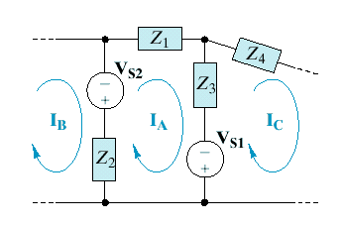
10.3 Mesh analysis
Circuit that can be drawn in a plane with no branches crossing one another.
planar circuit:
the sum of voltages around mesh A is
An example mesh

Slide 12
Example
Find the currents of i₁(t) and i₂(t) for the circuit by mesh analysis.

Slide 13
Solution:

Slide 14
The frequency domain equivalent circuit represented by phasors is:

Slide 15
By mesh current method:

Slide 16
The required currents of i₁(t) and i₂(t) are:

Slide 18
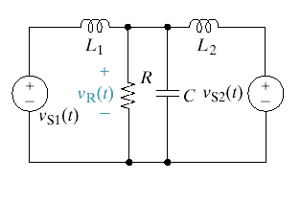
10.4 Superposition Theorem
Two cases:
Sources with same frequency
Sources with different frequencies
Case 1
Use superposition to find the steady - state voltage v_{R} (t). Given R=20Ω , L₁ = 2mH, L₂ = 6mH, C = 20 μF, V _{s1}= 100cos 5000t V , and V_{s2}=120cos (5000t +30 )V.

Slide 19
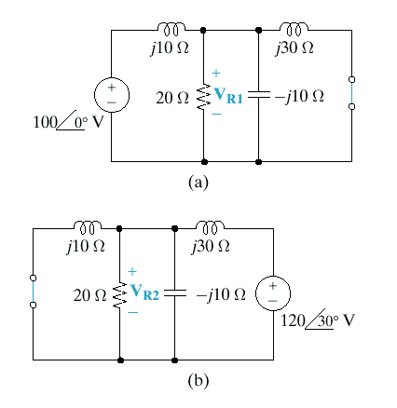
Solution:

Slide 21
Case 2
Example： Find v₀ in the circuit using the superposition theorem.
2H
1Ω
4Ω
v₀
5V
0.1F
2sin5t A
10cos2t V
Solution：
Let v₀=v₁+v₂+v₃
where v₁ is due to the 5V dc voltage source, v₂ is due to the 10cos2t V voltage source, and v₃ is due to the 2sin5t A current source.

Slide 22
To find v₁, we set all sources to zero except the 5V dc source. The equivalent circuit is as shown in the figure.
1Ω
4Ω
v₁
5V
v₁=-1V

Slide 23
To find v₂, we set to zero both the 5V source and the 2sin5t current source and transform the circuit to the frequency domain.
1Ω
4Ω
In the time domain
2H
1Ω
4Ω
v₀
5V
0.1F
2sin5t A
10cos2t V

Slide 24
To obtain v₃, we set the voltage sources to zero and transform the circuit to the frequency domain.
1Ω
4Ω
By current division
2H
1Ω
4Ω
v₀
5V
0.1F
10cos2t V
2sin5t A

Slide 25
In the time domain

Slide 26
10.5 Source Transformation

Slide 27
Use source transformation to find the steady state expression v₀ if v_{s1}=20cos(200t)V and v_{s2}=50cos(200t)V.

Slide 28
10.6 Thevenin and Norton equivalent circuits
Thevenin equivalent circuit in frequency domain
Norton equivalent circuit in frequency domain

Slide 29
Thevenin equivalent circuit
The frequency-domain version of a Thevenin equivalent circuit : a linear circuit is replaced by a voltage source in series with an impedance.
1
1
○
○
Z_{Th}
Linear circuit
+
_
○
1′
○
1′

Slide 30
Norton equivalent circuit
The frequency-domain version of a Norton equivalent circuit : a linear circuit is replaced by a current source in parallel with an impedance.
1
○
Linear circuit
○
1′

Slide 31

Thevenin and Norton equivalent circuits
Keep in mind the two equivalent circuits are related as
${\dot{V}}_{Th}$=$Z_{N}{\dot{I}}_{N}$ $Z_{Th}=Z_{N}$

Slide 32
Example： Find the Thevenin equivalent of the circuit as seen from terminals a-b.
1
4Ω
j3Ω
+
_
a
2Ω
-j4Ω
b
Solution：
1. To find , we apply KCL at node 1
Thus , the Thevenin voltage is

Slide 33
4Ω
j3Ω
2. Find Z_{Th}
a
2Ω
-j4Ω
j3Ω
b
4Ω
a
2Ω
-j4Ω
b

Slide 34
3. The Thevenin equivalent of the circuit.
a
○
Z_{Th}
+
_
○
b

Slide 35
10.7 Op amp ac circuits
The key to analyzing op amp circuits is to keep two important properties of an ideal op amp in mind :
No current enters either of its input terminals.(“virtual open-circuit”)
The voltage across its input terminals is zero. (“virtual short-circuit”)

Slide 36
Determine v₀(t) for the op amp circuit if v_{S}=3cos1000t V.
20kΩ
10kΩ
10kΩ
_
+
+
_
V_{S}
V₀
Solution：
We first transform the circuit to the frequency domain

Slide 37
20kΩ
10kΩ
10kΩ
_
1
2
V₀
+
+
_
Applying KCL at node 1, we obtain

Slide 38
20kΩ
10kΩ
10kΩ
_
1
2
V₀
+
+
_
At node 2, KCL gives
Hence

Slide 39
Exercise
Given
V₁ = 5 V，
V₂ = 5 V，find
V = ？
V₁
Solution:
Find the frequency domain circuit，
i
+
u_{s}
-
R
V
C
V₂
The frequency domain equivalent circuit
R
V =

Slide 40
+
-
Solution
Let the phasor voltage be the reference phasor (parallel connection)：
Phasor diagram

Slide 41
Given I₁=4 A，I₂=3 A，I₃=6A，find the effective value of I using phasor diagram.
R
_
+
Solution
Phasor diagram

